Slide 1

Using Strengths to Support Invitational Education
Dr. Jim Mahoney
August 2020

Slide 2
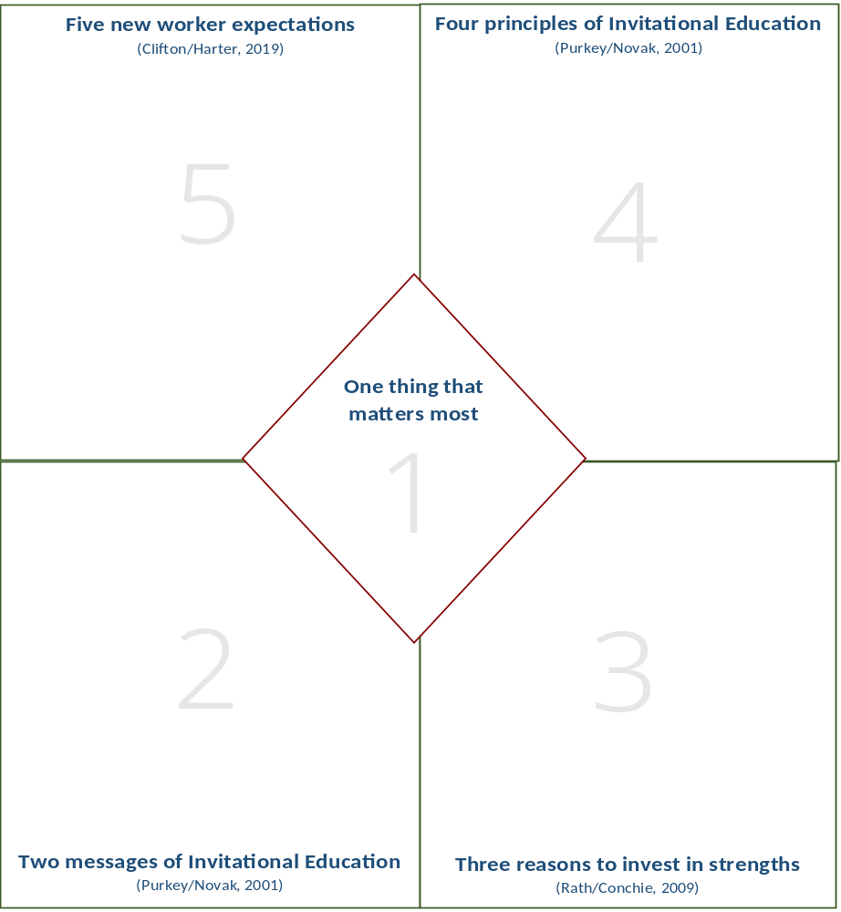
The Mahoney Five

Slide 3
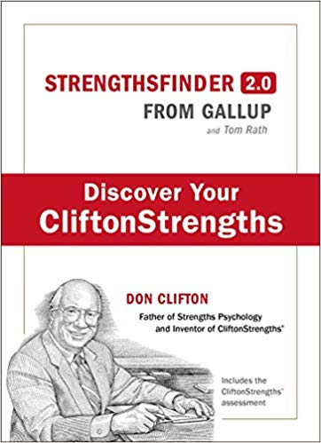

An Introduction to StrengthsFinder 2.0
Copyright Gallup 2018 Used with Permission
Notes:
It is important to note that the PowerPoint is the copyrighted work of the Ohio Strengths Center but the StrengthsFinder content is the property of Gallup and is protected by copyright. All participants should either buy the book or complete the survey on line. Our role is instructional support and guidance for the Gallup content.

Slide 4

Inviting School Success

Slide 5
Two Types of Messages
1. Inviting
2. Disinviting

Slide 6
Collaborative Activity
Describe a powerful, inviting message

Slide 7
New Worker Expectations
(Clifton/Harter)
Paycheck to purpose
Satisfaction to development
Bosses to coaches
Annual reviews to ongoing conversations
Weaknesses to strengths

Slide 8
Collaborative Activity
As you think about these new workplace demands, which ones resonate with you and why?

Slide 9
Four Principles of Invitational Education
Perceptual based on self-concept approach to education based on four principles --William Purkey
People are able, valuable, and responsible
Teaching should be a cooperative activity
People possess untapped potential
Potential can best be realized by programs, practices, and policies designed to invite development

Slide 10
Collaborative Leadership Activity
Who is the greatest leader you have ever known?
In one minute, list words or phrases that describe why he or she is the greatest leader you have ever known?
Circle the top 3 words or phrases on your list.
What does your list say about the impact this leader made on your life?
Notes:
Another engaging activity which can be done at each table. Groups seem to really like this one. This format will be used again as participants learn about their own strengths.

Slide 11
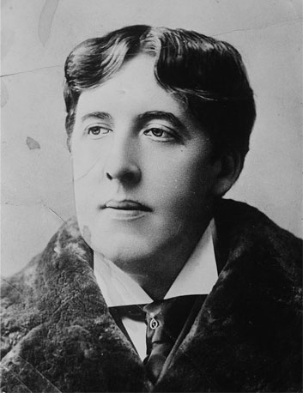
Testimonials
“Be yourself.
Everyone else is taken.”
Oscar Wilde

Slide 12
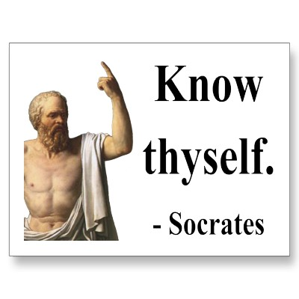

Slide 13
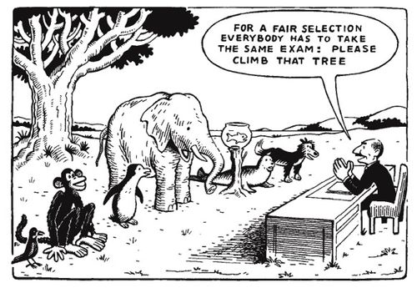

Slide 14
Would You Rather?
Give a eulogy or plan the funeral?
Be the best player on a team or be the coach?
Brainstorm a solution or implement a plan?
Meet new people you don’t know or spend time with old acquaintances?
Sell a new product or service delivery of the product?
Facilitate a meeting or recruit new members?
Write a report or make a presentation about the same topic?

Slide 15


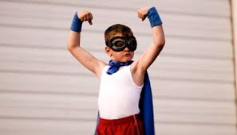

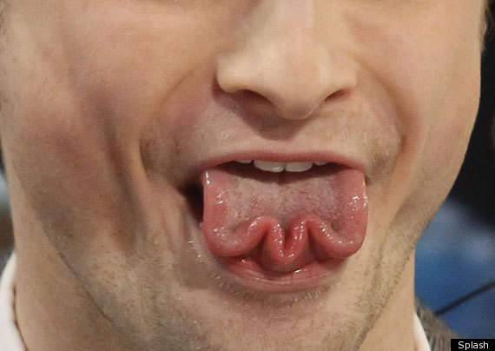

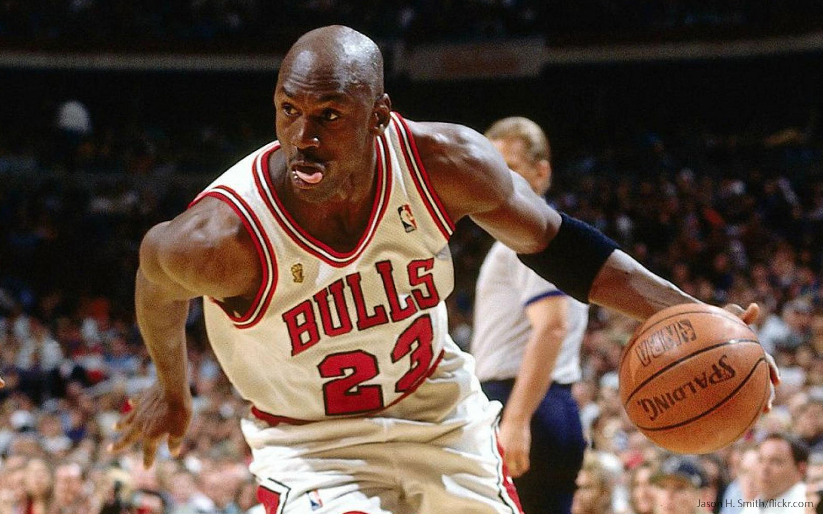
What Are You Really Good At Doing?
What is something that others often tell you that they think makes you stand out?
Discussion
Notes:
A good prompt might be, “What is it that others tell you that you are really good at?” What do you think you are good at?

Slide 16

Building Strengths
Talent
a natural way of thinking, feeling, or behaving
X
Investment
time spent practicing, developing skills, and building knowledge
=
Strength
the ability to consistently provide near-perfect positive performance

Slide 17
3 Reasons to Invest in Strengths
Will make you a better leader
Supports better teams
More likely to produce engagement

Slide 18
Gallup research proves that by proactively using your CliftonStrengths, you can be the best you!
7.8% People who know and use their CliftonStrengths are 7.8% more productive in their roles.
29% Business units that regularly use their Strengths show a 29% increase in profit.
6X People who know and use their CliftonStrengths are six times more likely to be engaged in their job.
15% Business units that regularly use their strengths have a 15% increase in employee engagement.
67% 67% of employees who agree that their manager focuses on their strengths are engaged at work. That percentage plummets to just 2% when employees disagree.

Slide 19
Collaborative Activity
Describe one of your signature strengths and how it helps you personally and/or professionally
According to Gallup studies of leadership, 70% of the variance of team performance depends upon what?

Slide 20
Question
According to Gallup studies of leadership, 70% of the variance of team performance depends upon what?

Slide 21
Final Thoughts
StrengthsFinder 2.0 has 34 strengths separated into four major quadrants. Students Explorer (for ages 10-14) has 10 themes. A pre-requisite to student themes is to identify and understand your own.
Ohio Strengths Center can facilitate the themes, training, and implementation to help you identify and play to your strengths.
Contact Leslie Damron (ldamron76@gmail.com) or Jim Mahoney (jmahoney.59@gmail.com) to learn more.

Slide 22
Using Your Strengths to Support Invitational Education
Dr. Jim Mahoney
Activator, Positivity, Woo, Maximizer, Communication
August 2020

