Slide 1
The Jessamine Early Learning Village
Nicholasville, Kentucky
United States of America

Slide 2
Greetings!!

Slide 3
A Wise Man Once Said….
“You’ve got to dance like there’s nobody watching,
Love like you’ll never be hurt,
Sing like there’s nobody listening,
And live like it’s heaven on earth.”
William Purkey

Slide 4
Jessamine County Schools, Kentucky
Located in Central Kentucky
One of the fastest growing districts in KY
Consists of both rural and urban areas
Serves 8000 students Preschool to 12th grade
Jessamine County Schools exists to motivate and challenge every child every day to be a caring, responsible citizen, and a high-level thinker, performer, communicator, and learner for life.

Slide 5
History of JELV
Opened in 2000 with 8 Kindergarten half day classrooms and 13 Preschool classroom.
The philosophy was to create an environment just for small students with a focus on early childhood education.
In 2010 they expanded to the current site where all day Kindergarten was a new option for parents.

Slide 6
Today
We serve approximately 960 students.
Our total staff is 150, including custodians and cafeteria staff.
Occupational Therapy, Physical Therapy, speech, vision, hearing, and special education are a few services we provide to students.

Slide 7
Our Students
We have 600 Kindergarten students ages 5 to 6
We have 360 Preschool students age 3 to 5 years old.
Students come from a wide variety of backgrounds, including race, socio-economic range, and nationalities.

Slide 8
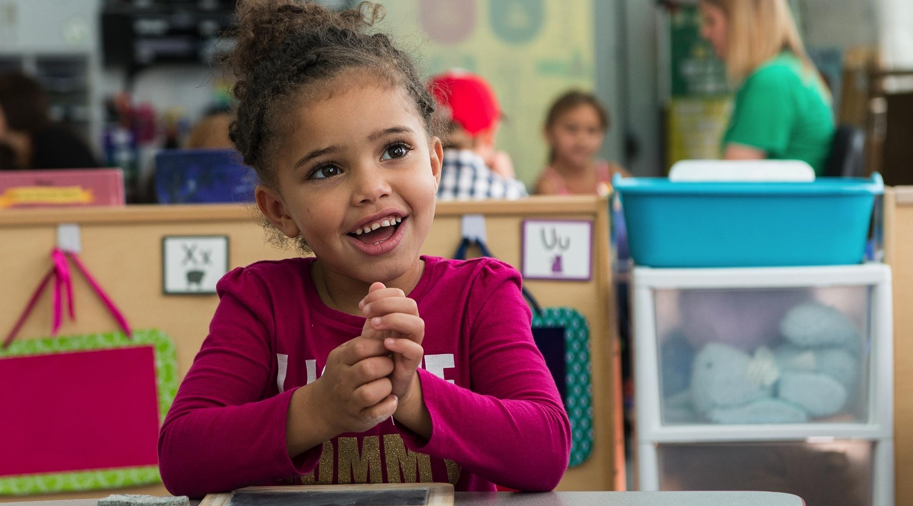
Recipe to Being an Invitational School

Slide 9
JELV and IAIE
The Jessamine Early Learning Village has been a partner of IAIE since 2000. Currently there are 3 schools who have received Fidelity Awards. Now, we have 5 schools applying for their first Fidelity Award.
Jessamine County Schools became a chapter in 2015. Our superintendent supports IAIE and encourages all Jessamine County Schools to be involved.

Slide 10
Involvement of Parents
JELV strives to involve parents through many various ways.
Family Fun Nights: 3 times a year
Parent Teacher Organization: Monthly evening meetings.
Parent Volunteers: Help the teachers and staff. Must be trained and a background check before starting.
Village Dads: We recruit men to volunteer.

Slide 11
Involvement of Staff
Committees meet monthly:
People: Help plan activities to bring the staff together, help with promoting social events, and help when we have guests in our school.
Places: Works with making our school safe
Programs: Looks at our Professional Development schedule and programs to bring to the school

Slide 12
Policies: Helps make decisions about policies pertaining to our school. This committee includes parents
Processes: Helps make decisions about curriculum, textbooks and materials

Slide 13
Welcoming Everyone
A warm and welcoming office
Phone is answered by a person, not a computerized message
Decorations, flowers and wreaths to create a home-like atmosphere
Positive greetings to all

Slide 14
Inviting Administration
Our philosophy is to start by being visible to parents, students and all staff.
Core Team meetings weekly to know how we can support one another.
Weekly communication to staff called “Teacher Talk”

Slide 15
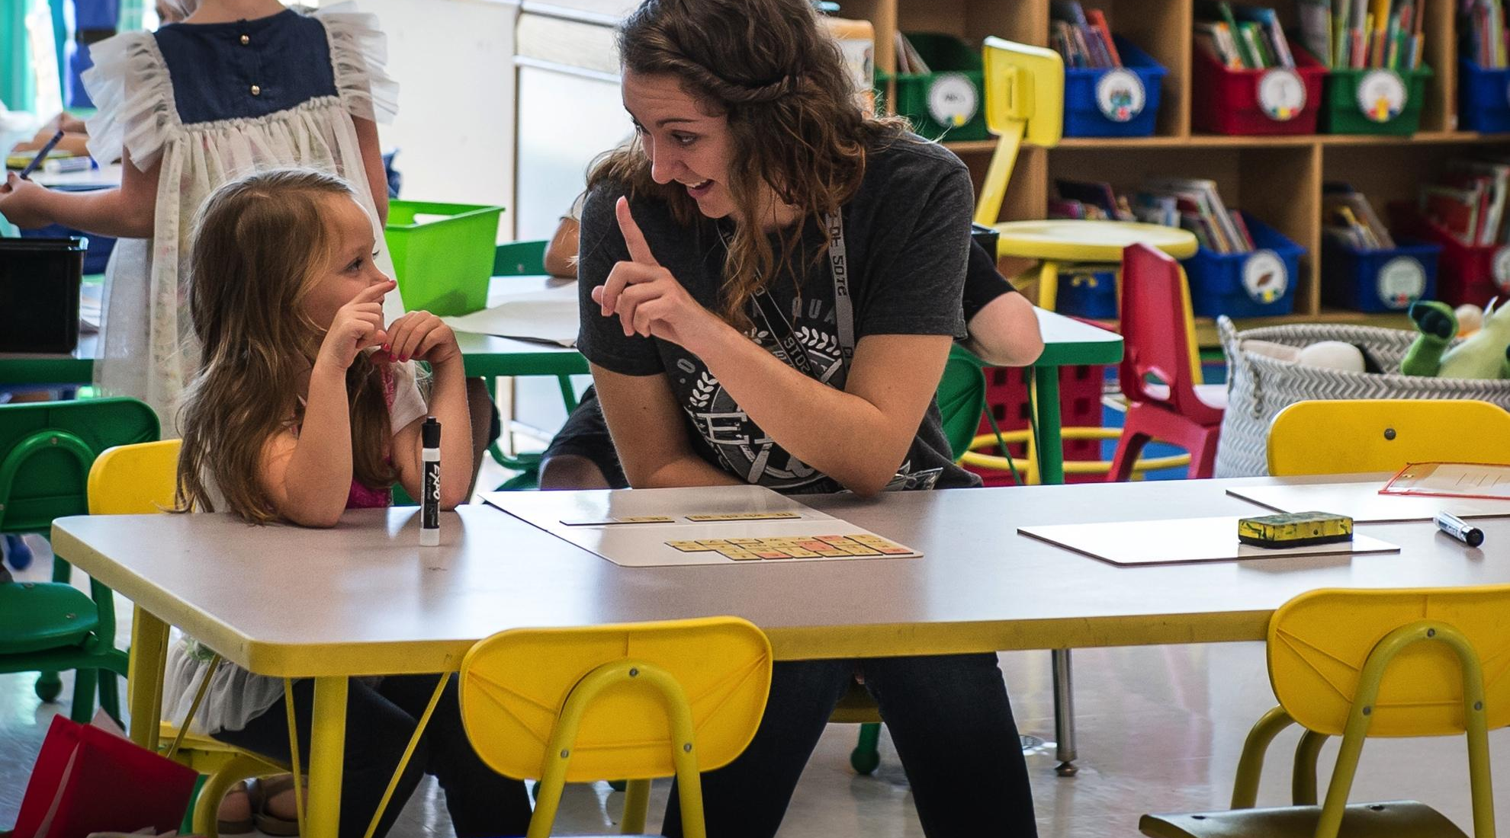
We Love All Students

Slide 16
Expectations
We stress school-wide discipline and expectations called the 5 Steps:
Safe hands and safe feet
Try your best
Express yourself
Play nice with others
Stop and Think

Slide 17
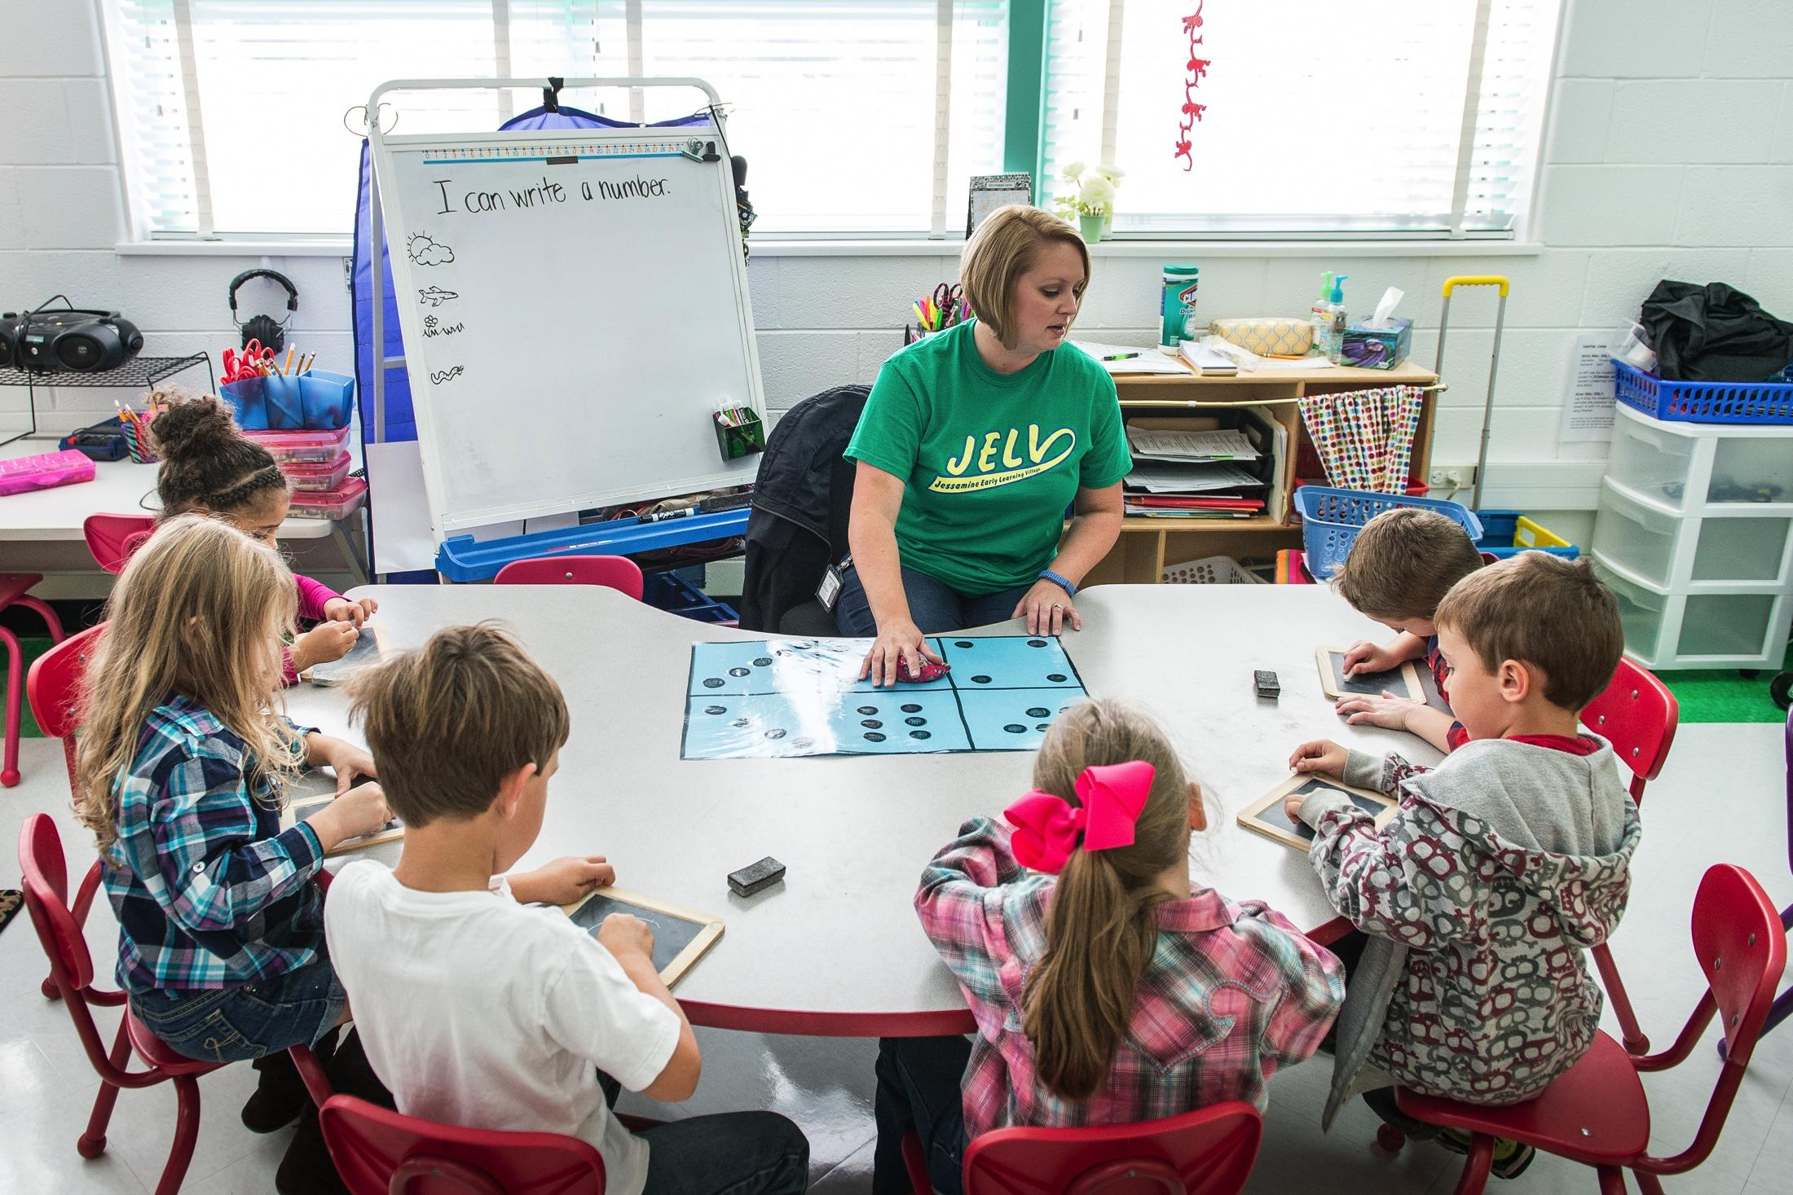

Slide 18
Instruction
We meet students where they are. We help support students who need extra help, and continue to challenge students who have already met the standards of learning.
Preschool has an hour per session of free play that is centered around creativity, math, science, art, drama, reading, and music.
Personalized plans are used to help make sure each student is progressing as needed.

Slide 19
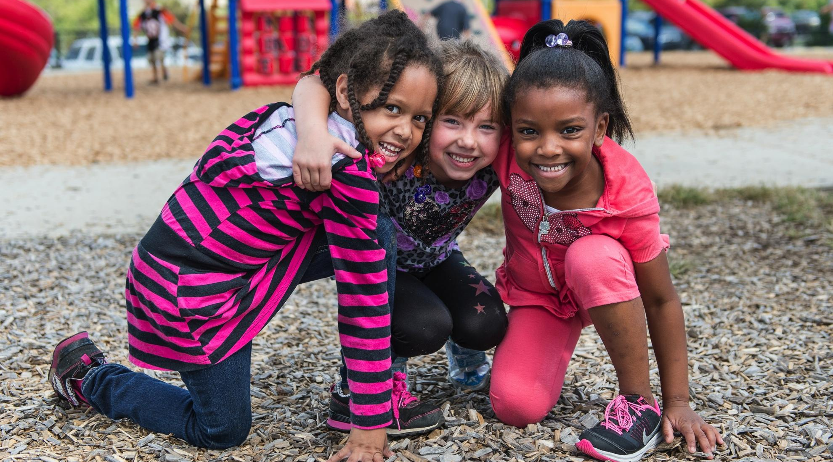
Friendships

Slide 20
Student Friendships
We encourage students to appreciate individual differences, respect one another and play with everyone.

Slide 21
Staff Friendships
We have a closed Facebook page to help with communication.
Our staff retreat included an “Amazing Race” scavenger hunt that included a photo with the superintendent.
At Christmas we have a gift exchange, and share a meal.
In the spring we have a staff/family picnic.

Slide 22
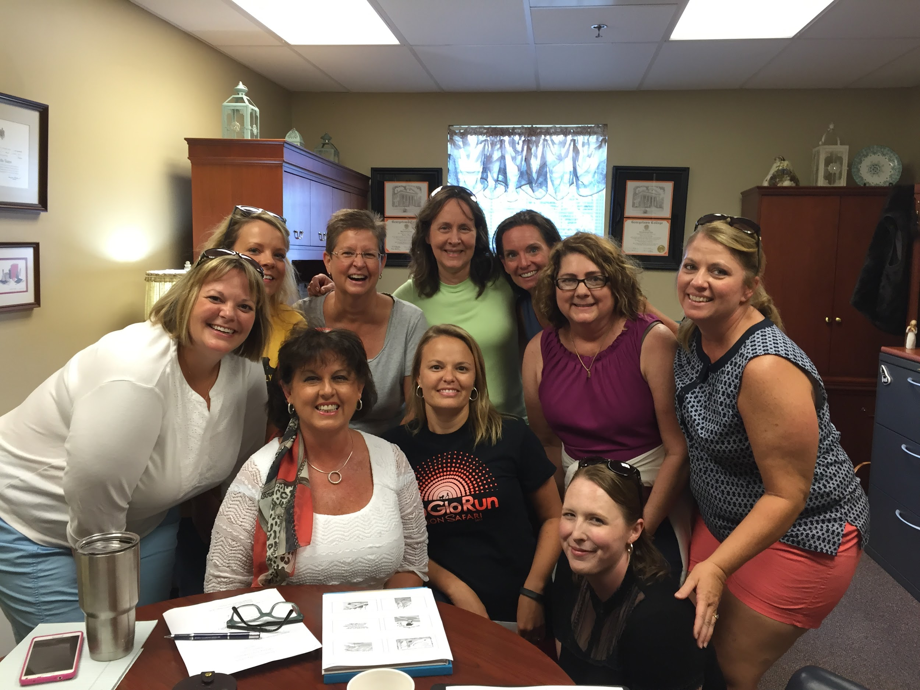
Staff with our Superintendent

Slide 23
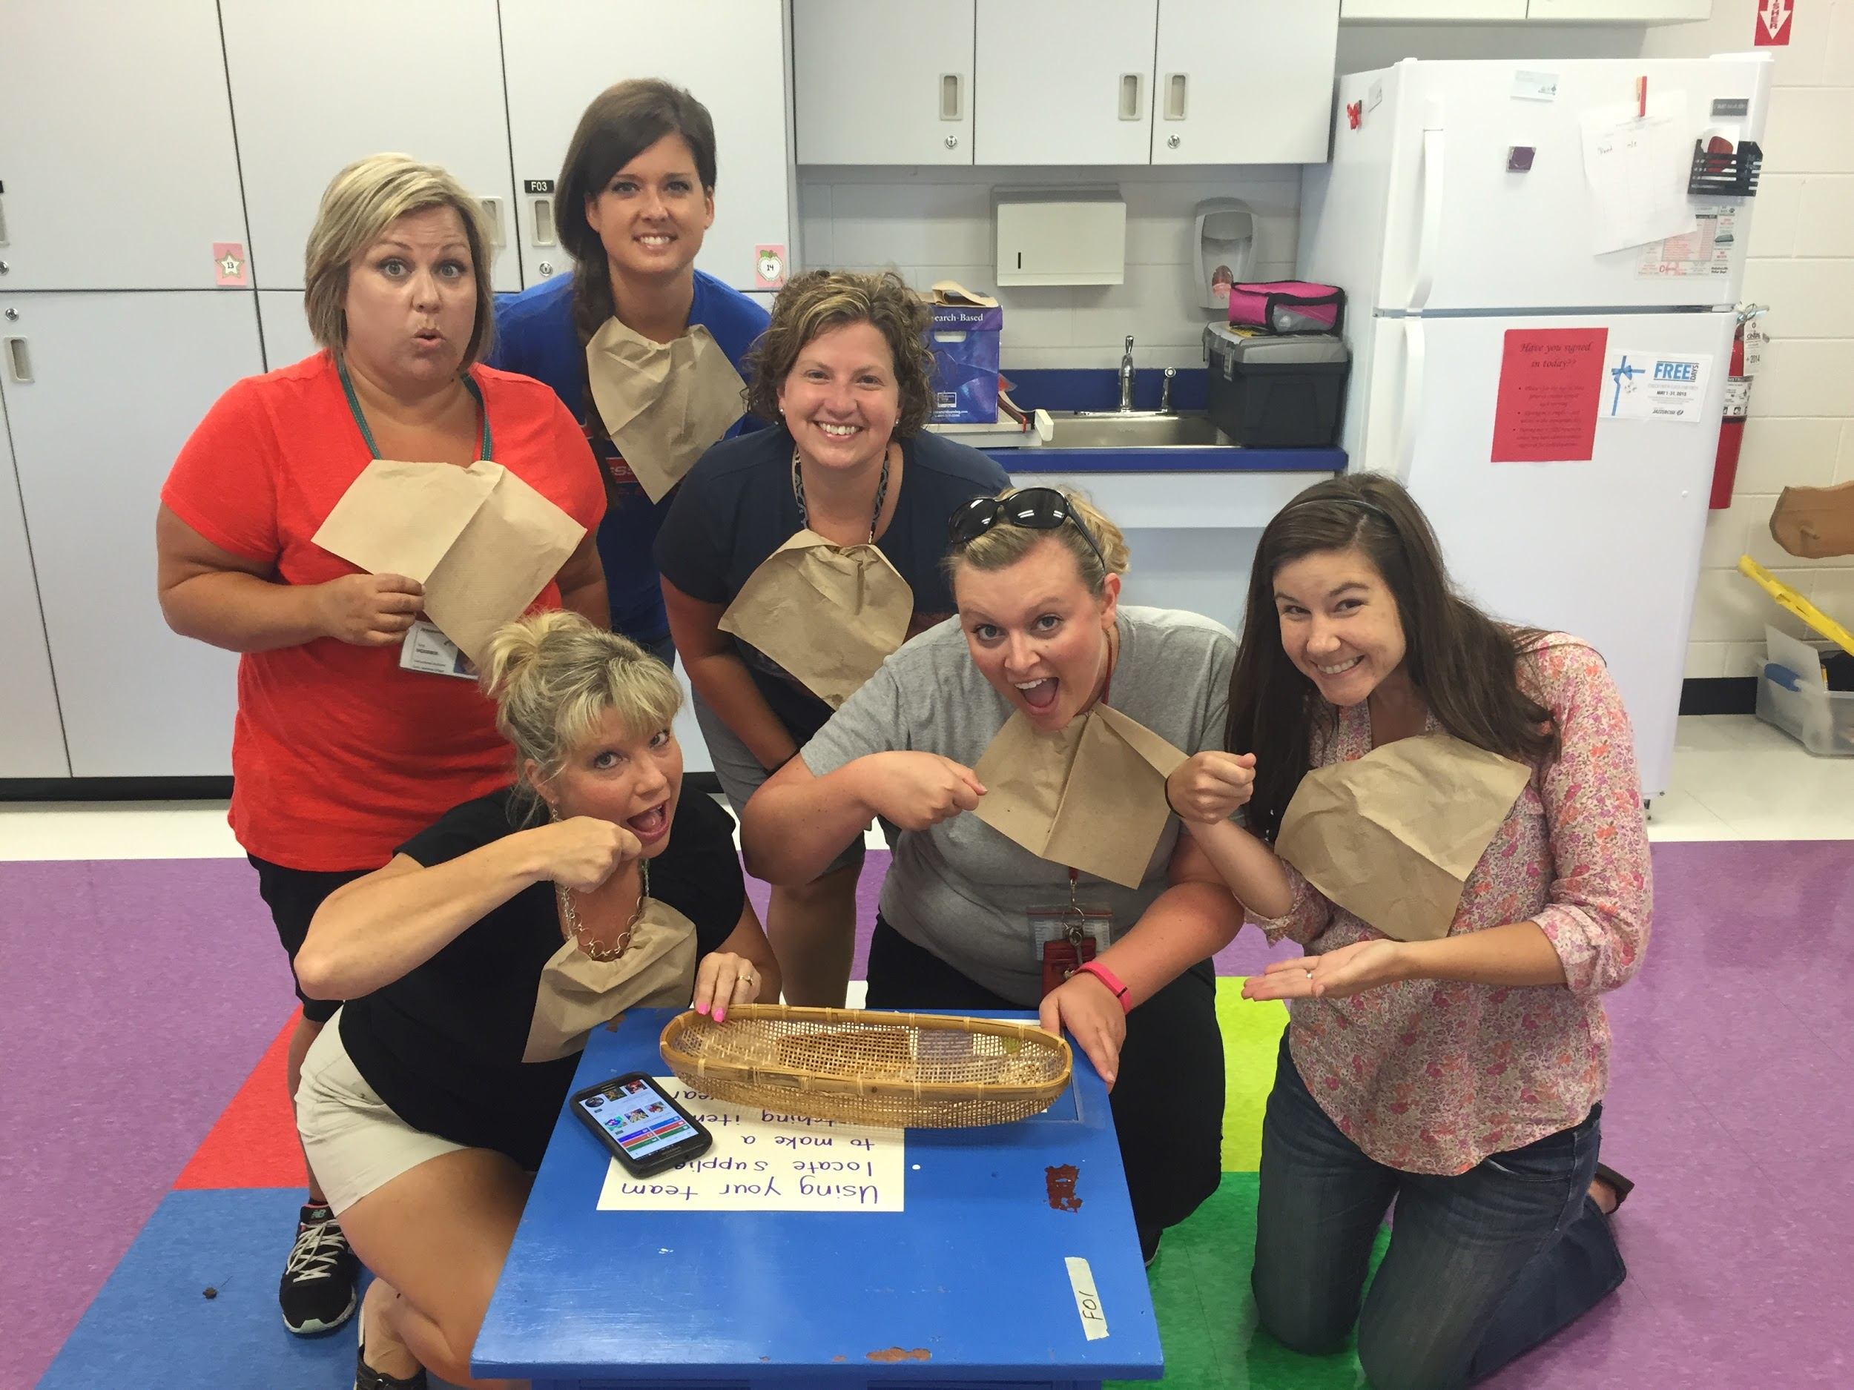
Team Building

Slide 24
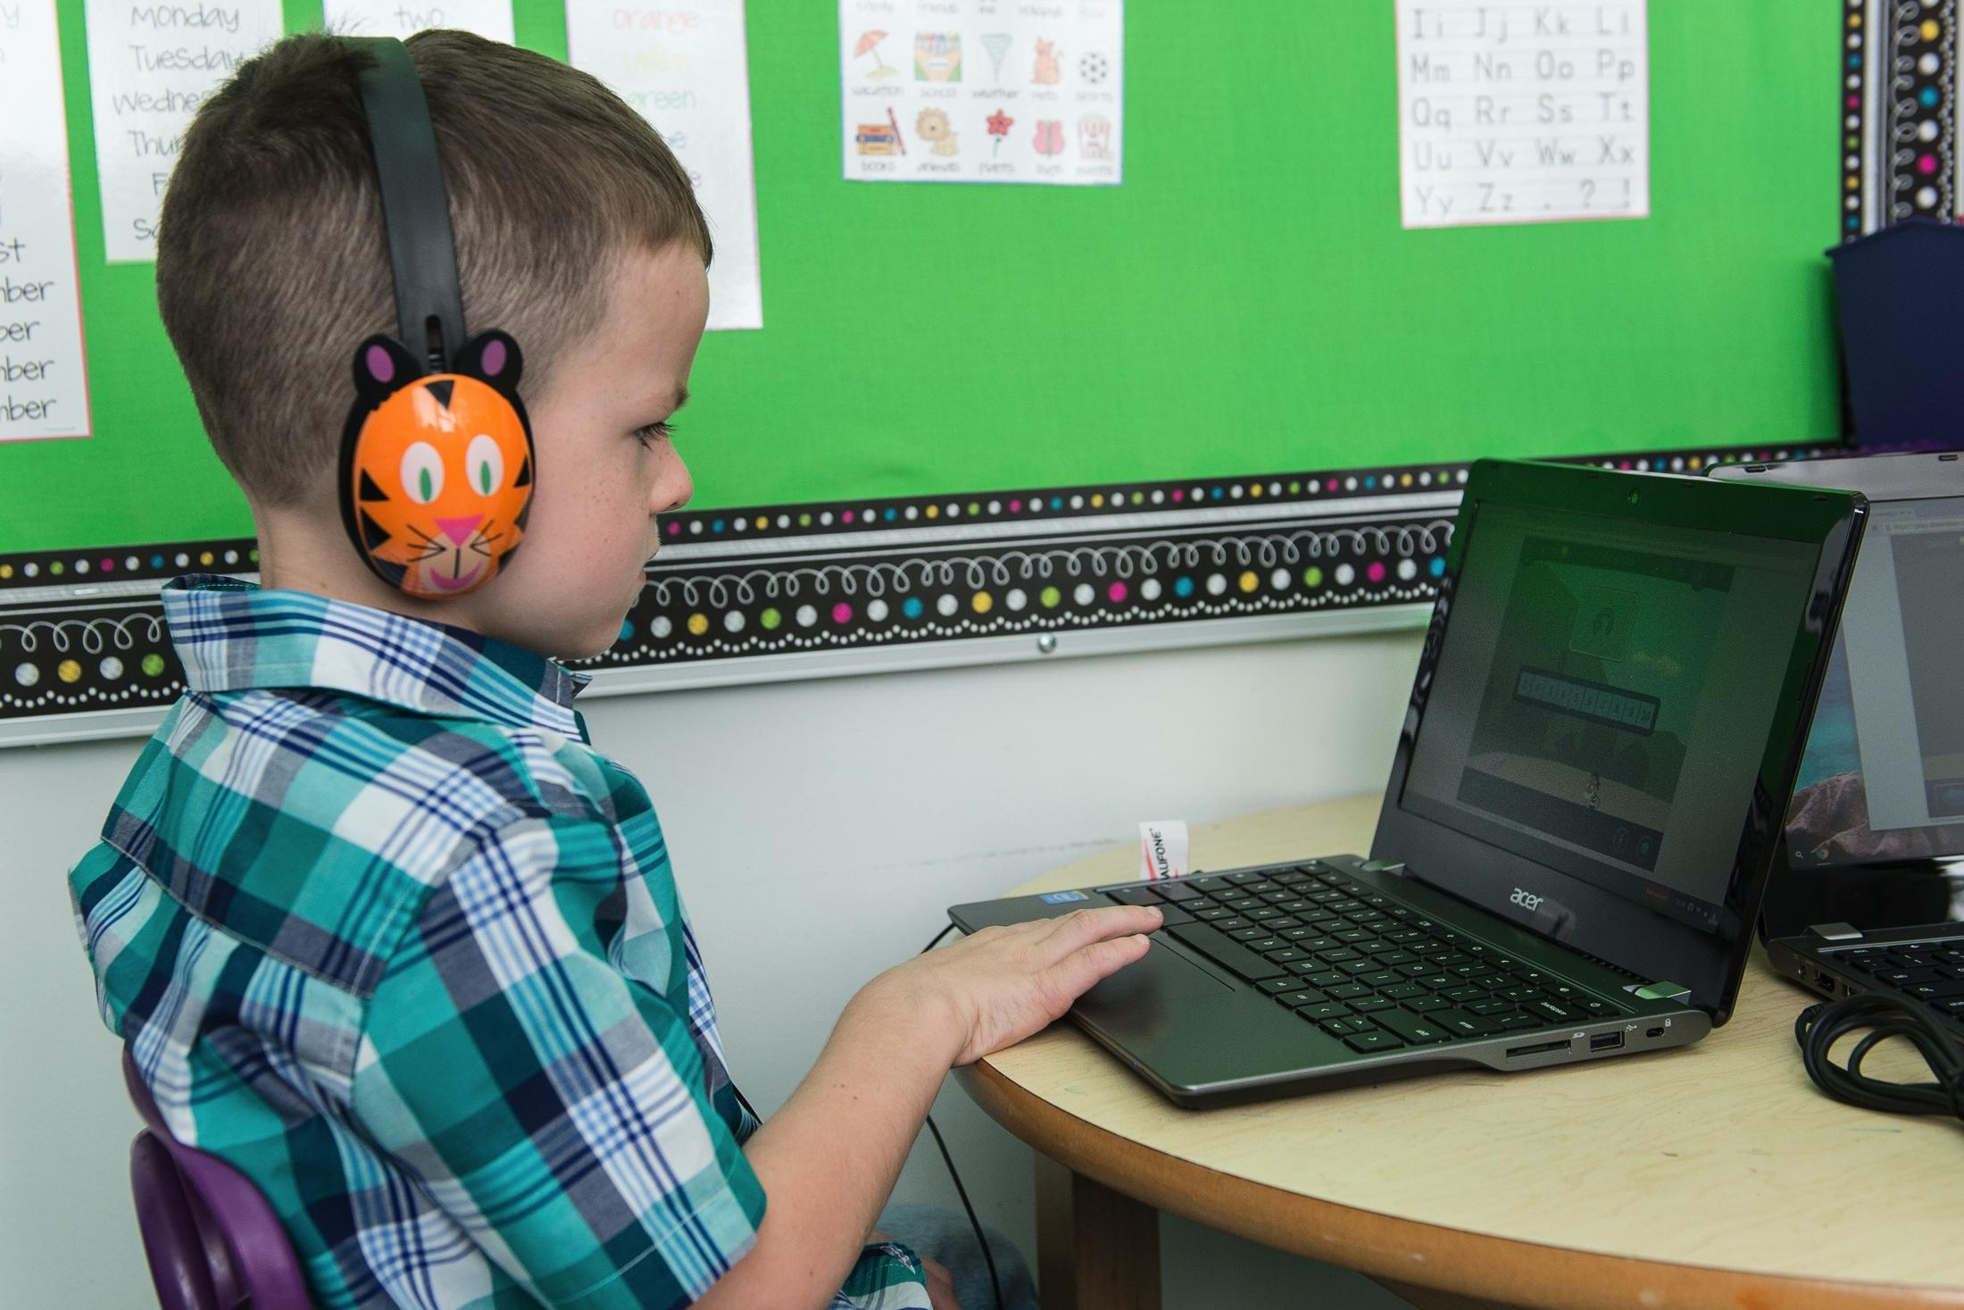
Technology

Slide 25
Moving to the 21 Century
We encourage and support technology for instruction.
Each classroom has an iBoard, Smartboard-like system.
Each classroom has access to iPads, Chromebooks and desktop computers.
Teachers have their own MacBook Pro which is used for faculty meetings and professional training.

Slide 26
Thank You!
Thank you to everyone who has made our trip to Hong Kong so very special.
You are welcome to come visit our school anytime!
gina.bernard@jessamine.kyschools.us

